Slide 1
Our commitment to 5-Star remarkable service.
MOC Training
2023

Slide 2
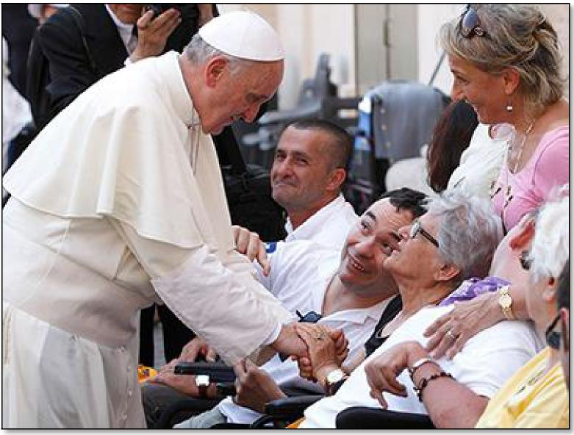
Our Mission
The mission of ArchCare, the Continuing Care Community of the Archdiocese of New York, is to foster and provide faith-based holistic care to frail and vulnerable people unable to fully care for themselves. Through shared commitments, ArchCare seeks to improve the quality of the lives of those individuals and their families.
Together, We Can... 2

Slide 3
Agenda
Training Objective:
Educate all providers, delegated vendors, and appropriate staff on the ArchCare Special Needs Plan (SNP) Model of Care, the goal of which is to enhance
member health outcomes through the use of an integrated care delivery system.
SNP Background
ArchCare SNP Model of Care
How Does MOC Work?
Care Coordination
Quality Measurement and Performance Improvement
Role and Responsibilities of Providers
Together, We Can... 3

Slide 4
SNP Background
What is a Special Needs Plan?
Congress created Special Needs Plans (SNP) in the Medicare
Modernization Act (MMA) of 2003 as a new type of Medicare managed care plan focused on certain vulnerable groups of Medicare beneficiaries.
What is Model of Care?
Model of Care (MOC) is the basic framework under which the SNP will identify and meet the needs of each of its enrollees.
The MOC requirements comprise the following clinical and nonclinical standards:
Description of the SNP Population
Care Coordination
SNP Provider Network
MOC Quality Measurement & Performance Improvement
SNP CLASSIFICATIONS Chronic SNP (C-SNP) -
for individuals with severe or chronic conditions
Institutional SNP (I-SNP) -
for individuals who are
institutionalized or eligible for nursing home care
Dual Eligible SNP (D-SNP) - for dual-eligible individuals
Together, We Can... 4

Slide 5
ArchCare SNP Model of Care
The ArchCare Model of Care strives to meet the specialized
needs of its members and to optimize their health outcomes by
using evidence-based practices with an appropriate network of providers and specialists.
Together, We Can... 5

Slide 6
How Does MOC Work?
ArchCare’s Model of Care promotes quality care management
and optimal health outcomes for members through facilitation of
access to needed resources and care coordination, including:
Coordinating care through a central point of contact—the member’s PCP, in collaboration with a ArchCare Care Manager or Care Management Team
Monitoring transitions through the timely coordination of care plans to ensure vulnerable SNP populations do not receive fragmented care
Providing preventive health, medical, mental health, social services, and added-value services
Beginning 1.1.2022 AA is the payer of Hospice benefits rather than Medicare FFS.
Together, We Can... 6

Slide 7
Care Coordination
ArchCare conducts Care Coordination to meet the targeted
needs of our members by utilizing the following strategies:
Conducting a Health Risk Assessment (HRA) of the individual’s physical, psychosocial, and functional needs, using a tool approved by CMS and other appropriate regulatory agencies
Developing a member’s Individualized Care Plan (ICP) using the results of the HRA and the member’s input
Each member has an Interdisciplinary Care Team (ICT) that manages the member’s care and meets regularly to manage the medical, cognitive, psychosocial, and functional needs of the member
Together, We Can... 7

Slide 8
Special Needs Plan Mode of Care Goals
Improving access and affordability to medical, mental health, and social services
Improving coordination of care and appropriate delivery of services through the direct alignment of the HRAT, ICP and ICT
Provide seamless transitions of care across all health care settings and providers
Improve use of preventive health services
Encourage appropriate utilization of services
Improve member health outcomes
Together, We Can... 8

Slide 9
Quality Measurement and Performance Improvement
SNPs strive to continuously improve their performance.
ArchCare monitors the effectiveness of the Model of Care through ongoing evaluation of member health outcomes. The information is reported at the
Quality Improvement Committee.
Evaluation of the Model of Care Committee includes collecting, analyzing, and reporting unique data related to each of ArchCare’s Special Needs Plans.
Model of Care metrics include:
Access to care
Improvement in member health status through specific metrics such as HEDIS, PCP Visits, Admission & Emergency Room utilization
Completion of comprehensive Health Risk Assessment
Implementation of an Individualized Care Plan (ICP) for SNP beneficiaries
Together, We Can... 9

Slide 10
Role of Providers
Providers are integral in the execution of and compliance with
the Model of Care elements
'Communicating with ArchCare Case Managers, members of the ICT, caregivers, and enrollees
'Participating in the ICT
'Collaborating with ArchCare to develop the ICP
'Maintaining the ICP in the member’s record
'Empowering the member to continue the treatment established in the ICP
'Updating the ICP as the member’s health status changes
'Submitting documentation in a timely manner
'Communicating the member’s plan of care before and after the member transitions from one care setting to another
'Utilizing the ArchCare evidence-based Clinical Practice Guidelines and Protocols, which are the foundation of the Care Management Program
Together, We Can... 10

Slide 11
Provider Responsibilities
What does this mean for providers?
It is important for SNP providers to understand:
The ArchCare Model of Care and its goal to enhance the medical and social health outcomes of our members.
Providers support the integrated care delivery system through:
Active involvement with the ICT
Collaboration with the ArchCare case management staff to:
maintain and update the member’s ICP
ensure cost-effective, appropriate care
Together, We Can... 11

Slide 12
SNP MOC Resources
What resources are available to help you participate with the SNP MOC?
Clinical Practice Guidelines via the ArchCare website’s Healthy Living sectionwww.ArchCare.org/live-healthy
Model of Care presentation
www.ArchCare.org/provider-annual-update/
Contact ArchCare Provider Services
1-800-373-3177
Monday to Friday, 9am–5pm
Together, We Can... 12

Slide 13
Thank you.
We value your partnership in delivering
quality healthcare to our members.
Your participation is appreciated, and we look
forward to working with you.
Please submit completion attestation online:
https://www.archcare.org/forms/archcare-advantage-model-care-training
Together, We Can... 13

Slide 14
Annual SNP Model of Care Training
Course Attestation
In order to acknowledge your completion of this course, you must review the acknowledgement statement below and sign and date, attesting you have completed review of all text included in this course.
I have completed the Annual SNP Model of Care Training by reviewing all information in the training document.
Date Tax Identification Number
Print Name of Practice or Company National Provider Identifier
Signature

